Slide 1
Value Chain Analysis
Becca Bochna - GB570
Research Assignment

Slide 2
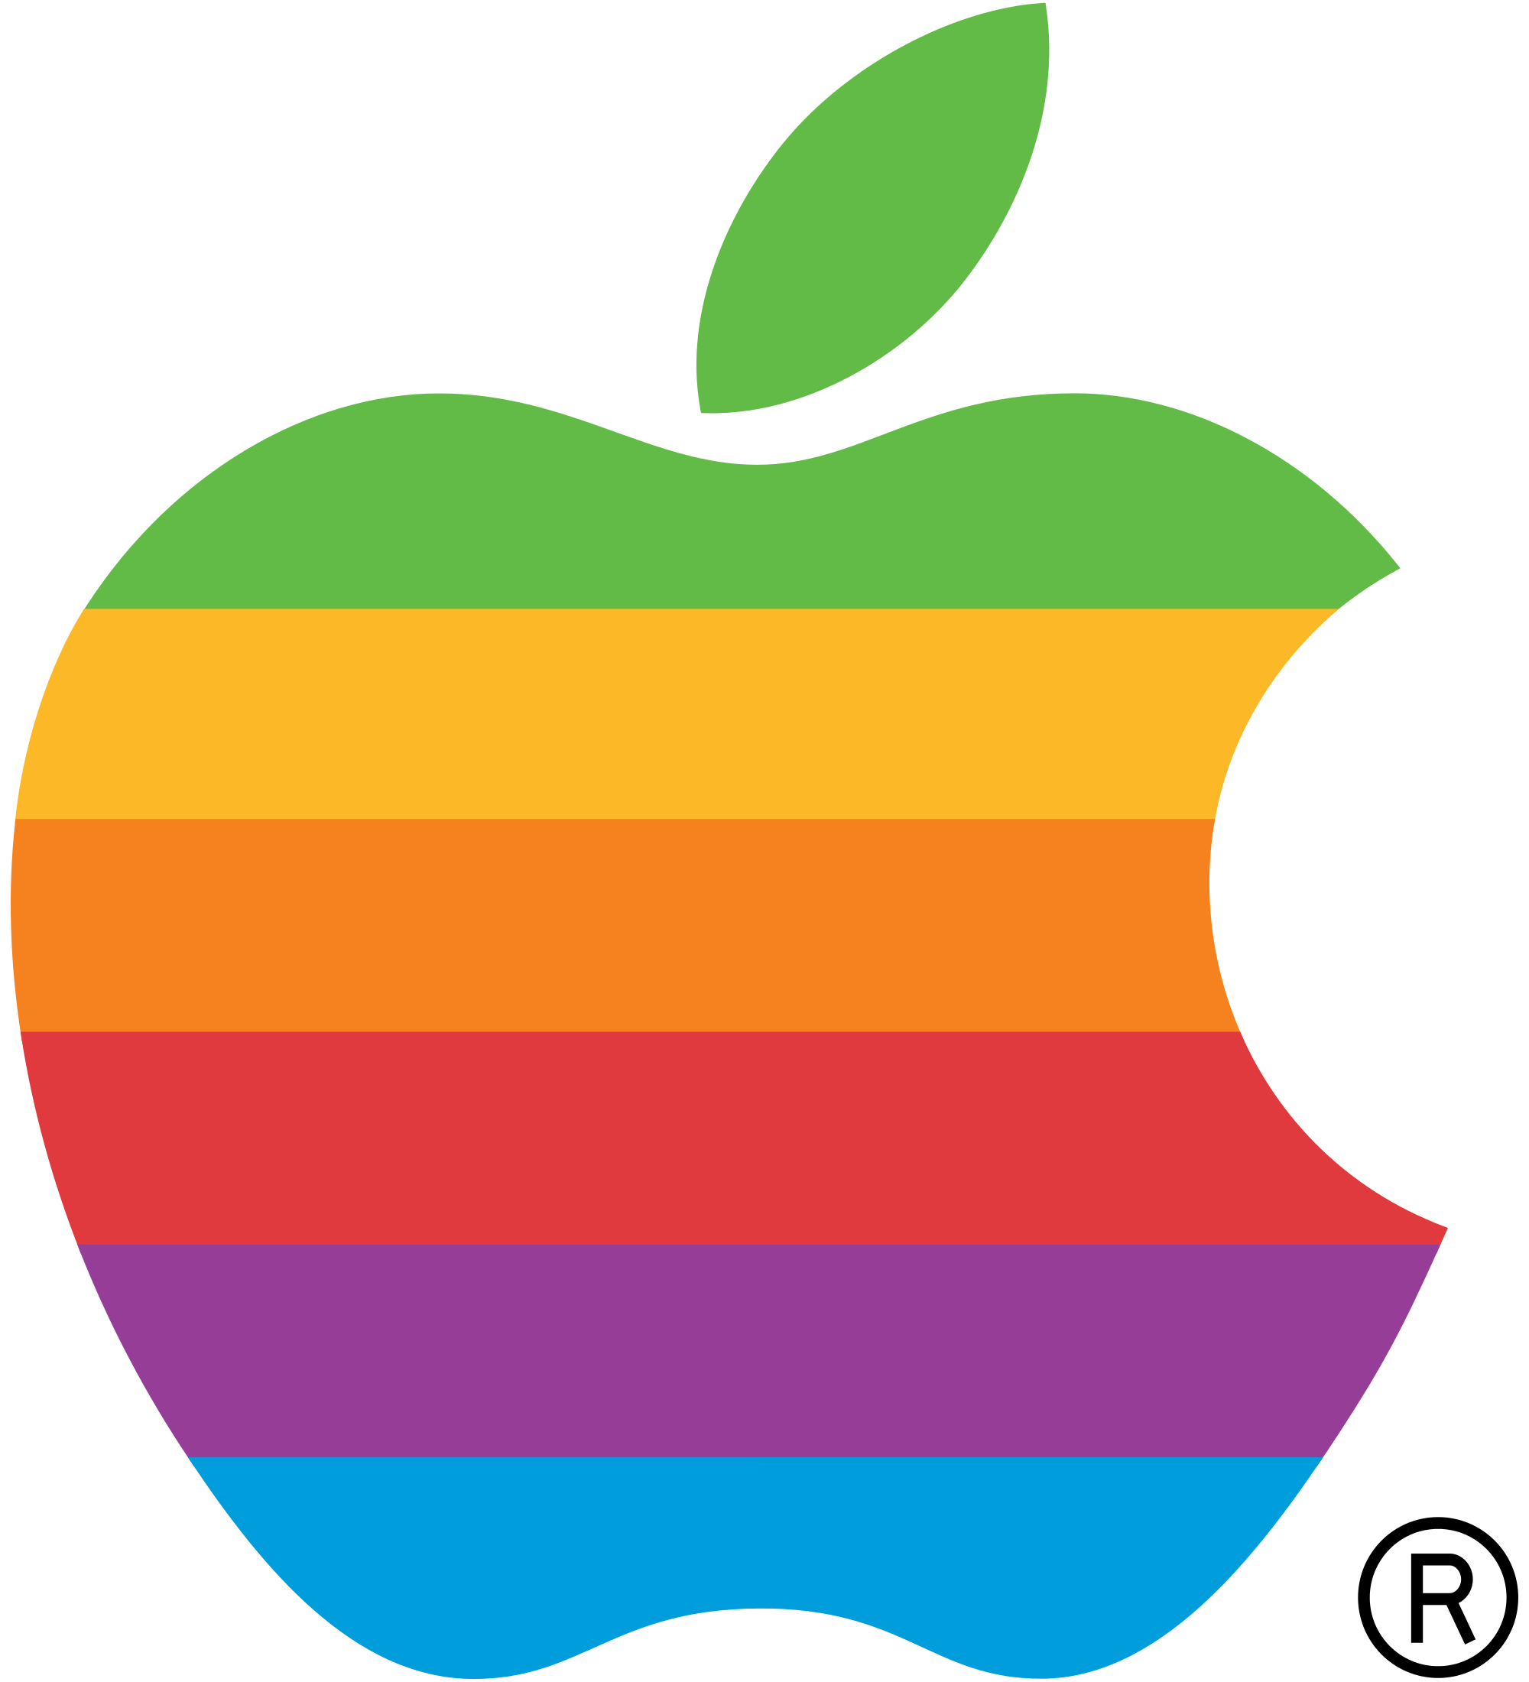
Apple Inc.
One of the largest technology companies in the world
Founded in 1997 by Steve Jobs, Steve Wozniak, and Ronald Wayne
Located in Cupertino, California
Products
  iPhone, iPad, Mac Computers (various), Apple Watch, Apple TV, and Apple Vision
Services
  App Store, Apple Music, and iCloud

Slide 3
Apple Inc.
Figures & Financial Information
Market Capitalization
As of late 2023, Apple's market capitalization is typically over $2 trillion, making it one of the most valuable companies in the world.
Revenue
Apple showed a current ratio of 0.92 in Financial strength
Net Income
Apple reported a net income of about $94 billion for the most recent fiscal year
Dividends
Apple has been paying dividends since 2012 and has increased its dividend payout annually, reflecting its robust financial health.
Employees
Apple employs over 160,000 people globally
R&D Expenses
In 2022, the company spent approximately $27 billion on R&D.
Stock Performance
Apple reached an all-time high in closing price on 12/26/24 at $259.02
Apple - 45 year stock price history: AAPL. Macrotrends. (n.d.). https://www.macrotrends.net/stocks/charts/AAPL/apple/stock-price-history
Apple (AAPL) market cap & net worth. Stock Analysis. (n.d.). https://stockanalysis.com/stocks/aapl/market-cap/
Apple Inc Com (AAPL:NAS) mergent Market Atlas. Search for companies based on location, industry classification and financial characteristics. (n.d.). https://marketatlas.mergent.com/stock/overview/?symbol=AAPL
Apple Net Income 2005-2024 | statista. (n.d.). https://www.statista.com/statistics/267728/apples-net-income-since-2005/

Slide 4

Marketing Manager for Apple Inc.
Market Research
Strategic Planning
Product Development
Execution of Campaigns
Customer Relationship Management
Performance Analysis
Key Responsibilities

Slide 5
Marketing Manager for Apple Inc.
Relation to the Contemporary Value Chain
Linking Strategies
Enhancing Customer Experience
Driving Innovation
Collaboration Across Functions
Sustainability and Ethics
Presutti & Mawhinney, 2013

Slide 6
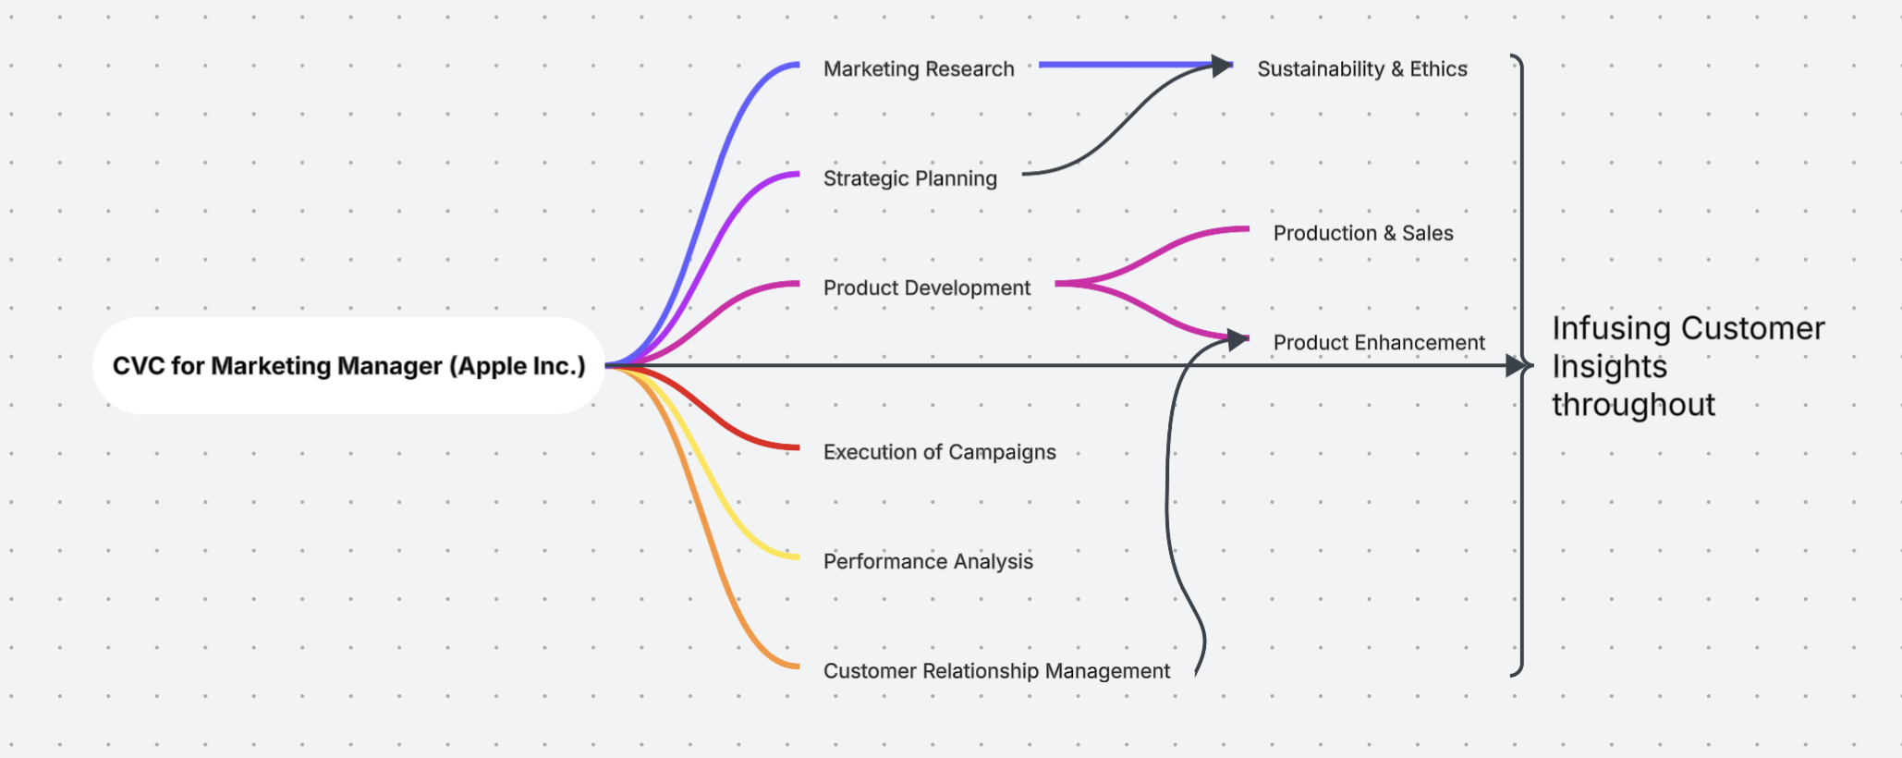
Marketing Manager Mind Map
Contemporary Value Chain - Apple Inc.

Slide 7
Marketing Mind Map
Contempory Value Chain - Apple Inc.
Linking Strategies
Connecting product development, production, and sales
Enchancing Customer Experience
Infusing customer insights throughout the value chain
Driving Innovation
Capturing feedback to inspire product enhancements
Collaboration Across Functions
Working with finance, sales, and operations
Sustainability and Ethics
Advocating for responsible marketing practices
Value Creation
Ensuring marketing aligns with overall business objectives
Competitive Advantage
Focusing on unique customer value propositions
Presutti & Mawhinney, 2013

Slide 8
Apple Inc. SWOT Analysis
Strengths
Strong Brand Identity
Diverse Product Range
Robust Financial Performance
Innovation and R&D
Ecosystem Integration
Opportunities
Market Research
Strategic Planning
Product Development Collaboration
Campaign Execution
Performance Analysis
Threats
Rapid Technological Advancements
Supply Chain Vulnerabilities
Shifting Consumer Preferences
Brand Reputation Management
Global Trade Tensions
Weaknesses
High Pricing Strategy
Dependence on iPhone Sales
Limited Customization Options
Compatibility Issues
Privacy and Security Concerns

Slide 9

Key Competitor
Apple Inc. vs. Samsung Electronics
Samsung’s Comprehensive Value Chain
Innovation
  Research & Development
  Product Design
Quality Control
  Manufacturing Excellence
  Supplier Relationships
Cost Efficiency
  Economies of Scale
  Vertical Integration
Customer-Centric Approach
  Market Research
  Customer Service
Sustainability
  Environmental Responsibility
  Sustainable Products
Global Research
  Diversified Markets
  Distribution Channels
Technological Leadership
  Cutting-Edge Technologies
  Ecosystem Development
Sustainable Supply Chain: Sustainability. Samsung us. (2025, February 3). https://www.samsung.com/us/sustainability/sustainable-supply-chain/

Slide 10
Key Competitor
Apple Inc. vs. Samsung Electronics
Samsung Electronics SWOT Analysis
Strengths
Brand Recognition
Diverse Product Range
Strong R&D Investment
Global Presence
Weaknesses
Legal Challenges
Dependence on Smartphone Market
Price Competition
Complex Organizational Structure
Opportunities
Emerging Markets
5G Technology
Smart Home Solutions
Sustainability Initiatives
Threats
Intense Competition
Rapid Technological Changes
Economic Fluctuations
Supply Chain Disruptions

Slide 11
Comparing Value Chains
Apple Inc. vs. Samsung Electronics
Inbound Logisitcs
Apple: relies on global network of suppliers
Samsung: benefits from vertically integrated supply chain
Operations
Apple: focused on assembling products in select locations (China)
Samsung: operates a more diversified production model
Outbound Logistics
Apple: distributes products through a mix of direct & indirect channels
Samsung: broad system utilizing multiple partnerships
Marketing and Sales
Apple: Emphasizes lifestyle and product differentiation
Samsung: employs aggressive marketing tactic across multiple channels
Service
Apple: online, in-person, and phone support – plus and extensive warranty program
Samsung: in-store and online resources
Presutti, W. D., & Mawhinney, J. R. (2013). Understanding the dynamics of the value chain. Business Expert Press, LLC

Slide 12
What if they merged?
The Marketing Manager’s perspective
Brand Identity Confusion
Increased Competition for Market Share
Misalignment of Marketing Strategies
Regulatory and Public Relations Challenges
Operational Complexity
Innovation Stagnation
H., V., & Manmadhan, M. (2022). Financial Implication of Merger and Acquisition on the Performance of Companies. International Journal of Financial Management, 12(1), 1–10.

Slide 13
What if they Merged?
Strategic Recommendations for Merger
Align
Align Business Objectives
Conduct
Conduct Thorough Due Diligence
Integrate
Integrate Value Chains
Enhance
Enhance Product and Service Offerings
Leverage
Leverage Technology
Foster
Foster Cultural Integration
Implement
Implement Change Management Strategies
Establish
Establish Clear Communication Channels
Measure
Measure Performance and Adjust
H., V., & Manmadhan, M. (2022). Financial Implication of Merger and Acquisition on the Performance of Companies. International Journal of Financial Management, 12(1), 1–10.

Slide 14
Strategic Initiatives for Optimizing the Value Chain
Technology Adoption
Initiative: Unified Marketing Technology Stack
Description: Merge CRM, analytics, and automation tools into one platform for streamlined processes
Benefits:
Improves Data Analysis and reporting
Enables real-time campaign tracking
Boosts inter-department collaboration
Barriers: Resistance to change
Solution: Provide training and pilot programs to demonstrate benefits
Cross-Functional Team Efficiencies
Initiative: Cross-Functional Marketing Teams
Description: Create teams with members from various departments to enhance collaboration
Benefits:
Greater understanding of challenges
Optimized marketing execution
Aligned objectives
Barriers: Siloed
Solution: Schedule regular meetings and set shared goals to promote teamwork
Strategic Procurement
Initiative: Centralized Procurement Strategy
Description: Consolidate suppliers and negotiate contracts for better buying power
Benefits:
Lower Costs
Ensures consistent branding
Strengthens supplier relationships
Barriers: Disruption of relationships
Solution: Transition gradually and involve current suppliers in discussions
Presutti, W. D., & Mawhinney, J. R. (2013). Understanding the dynamics of the value chain. Business Expert Press, LLC

Slide 15
Strategic Initiatives for Optimizing the Value Chain
Key Strategies
Change Management Communication
Feedback Loops
Pilot Programs
Performance Metrics
Presutti, W. D., & Mawhinney, J. R. (2013). Understanding the dynamics of the value chain. Business Expert Press, LLC

Slide 16
References
Apple - 45 year stock price history: AAPL. Macrotrends. (n.d.). https://www.macrotrends.net/stocks/charts/AAPL/apple/stock-price-history
Apple (AAPL) market cap & net worth. Stock Analysis. (n.d.). https://stockanalysis.com/stocks/aapl/market-cap/
Apple Inc Com (AAPL:NAS) mergent Market Atlas. Search for companies based on location, industry classification and financial characteristics. (n.d.). https://marketatlas.mergent.com/stock/overview/?symbol=AAPL
Apple Net Income 2005-2024 | statista. (n.d.). https://www.statista.com/statistics/267728/apples-net-income-since-2005/
H., V., & Manmadhan, M. (2022). Financial Implication of Merger and Acquisition on the Performance of Companies. International Journal of Financial Management, 12(1), 1–10.
Presutti, W. D., & Mawhinney, J. R. (2013). Understanding the dynamics of the value chain. Business Expert Press, LLC
Sustainable Supply Chain: Sustainability. Samsung us. (2025, February 3). https://www.samsung.com/us/sustainability/sustainable-supply-chain/
.

